Slide 1
Office 365 Development

Slide 2
Universal Windows App Development with Office 365 APIs in Visual Studio 2013
Speaker
Speaker

Slide 3

Agenda
Introduction
Universal App projects
Integrating Office 365 APIs

Slide 4















Vision
EXTEND OFFICE EVERYWHERE
CONNECT TO OFFICE 365 SERVICES
BUILD USING AN OPEN PLATFORM
Delve
z
Users and groups
Files
Mail
Calendar
My Apps
Video Portal
Contacts
Office Graph
Presentations
Documents
Spreadsheets
Lync
OneNote
Yammer

Slide 5
Introduction

Slide 6
Universal Windows Apps
Announced at //build/ 2014
Three major goals
Reach customers across phones, tablets and PCs
Deliver innovation that supports developer investments
Make cross-platform technology easier and more capable
Delivered in Visual Studio 2013 Update 2

Slide 7
Universal App Project

Slide 8
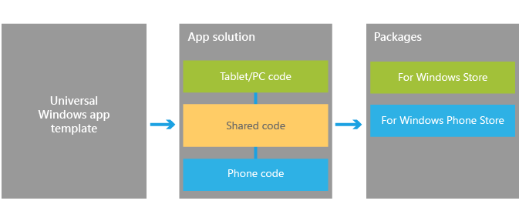
Visual Studio support
Windows App Certification Kit
Project template
Notes:
https://dev.windows.com/en-us/develop/Building-universal-Windows-apps
The Windows App Certification Kit has been extended to Phone apps. This allows a universal app to be in both Stores

Slide 9
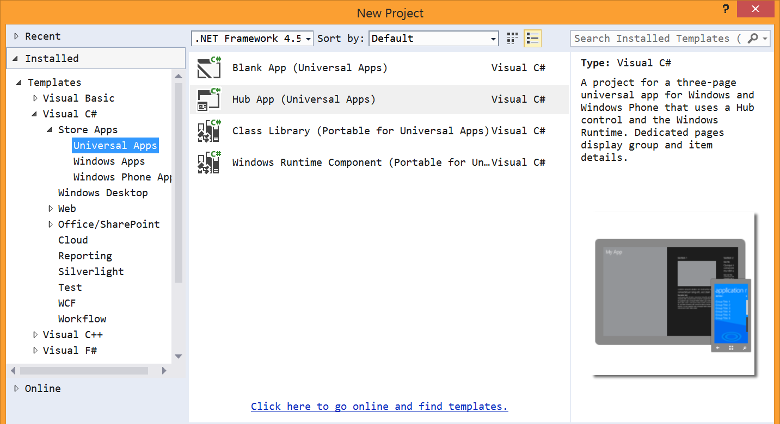
Universal App project template

Slide 10
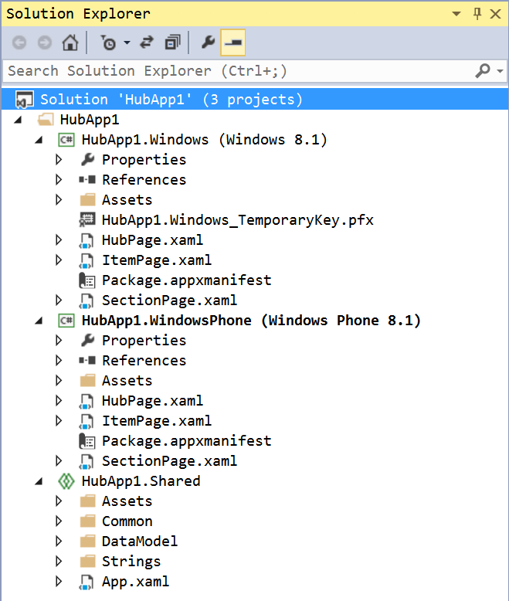
Universal App project template
Solution contains three projects
Windows
Phone
Shared
Shared is a special project type
File type is “shproj”
Does not contain references
Does not build

Slide 11
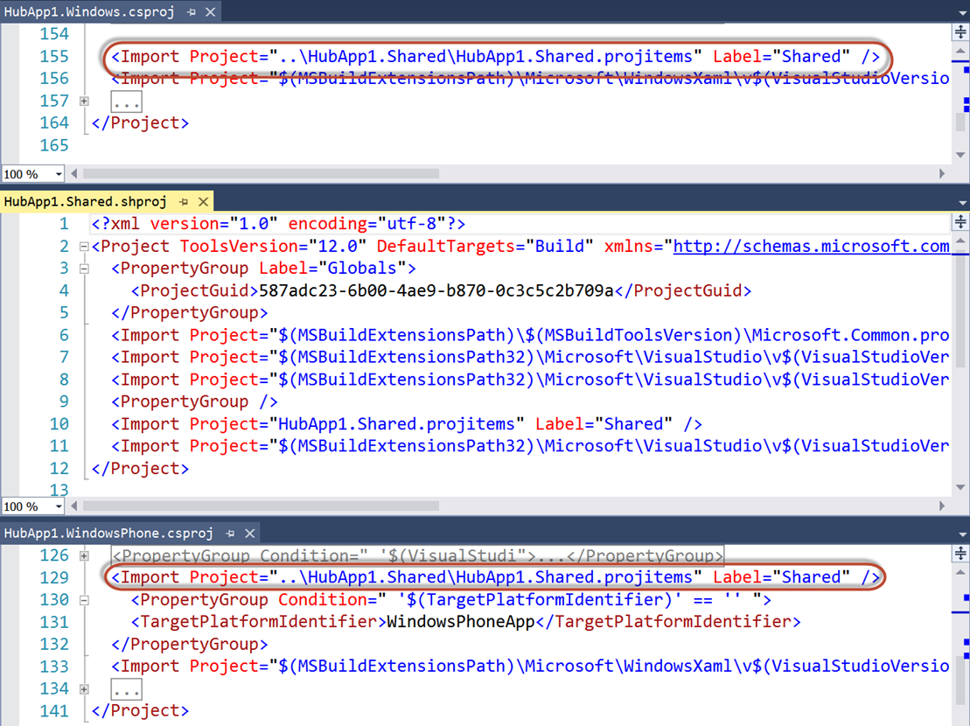
Universal App project template
Shared items imported into other projects
Compile-time constants
#if WINDOWS_APP
#endif
#if WINDOWS_PHONE_APP
#endif

Slide 12
Universal App project template
Contains sample data in Shared project
SampleData.json
Phone app is completely data-bound
Windows app only binds “Section 3”

Slide 13
demo
Universal App template
Notes:
Create a new HubApp project. Show the sample data and datasource
Right-click on windows app, set as startup project. Then open code-behind of HubPage and show the NavigationHelper_LoadState method. Point out the call to the sample data source. Run the project (F5)
Right-click on phone app, set as startup project. Again, show code behind of HubPage, pointing out the similarities. The same method loads the same sample data. Run the project (F5)

Slide 14
Integrating Office 365

Slide 15
Add Office 365 to Universal App
Add Connected Service
Need to add to both Windows and Phone projects
As of September 2014, Office 365 libraries not compatible for Phone projects
Create a data source
XAML makes heavy use of data binding, embrace that paradigm
Stateful client
Initiate login/consent and store Discovery Context

Slide 16
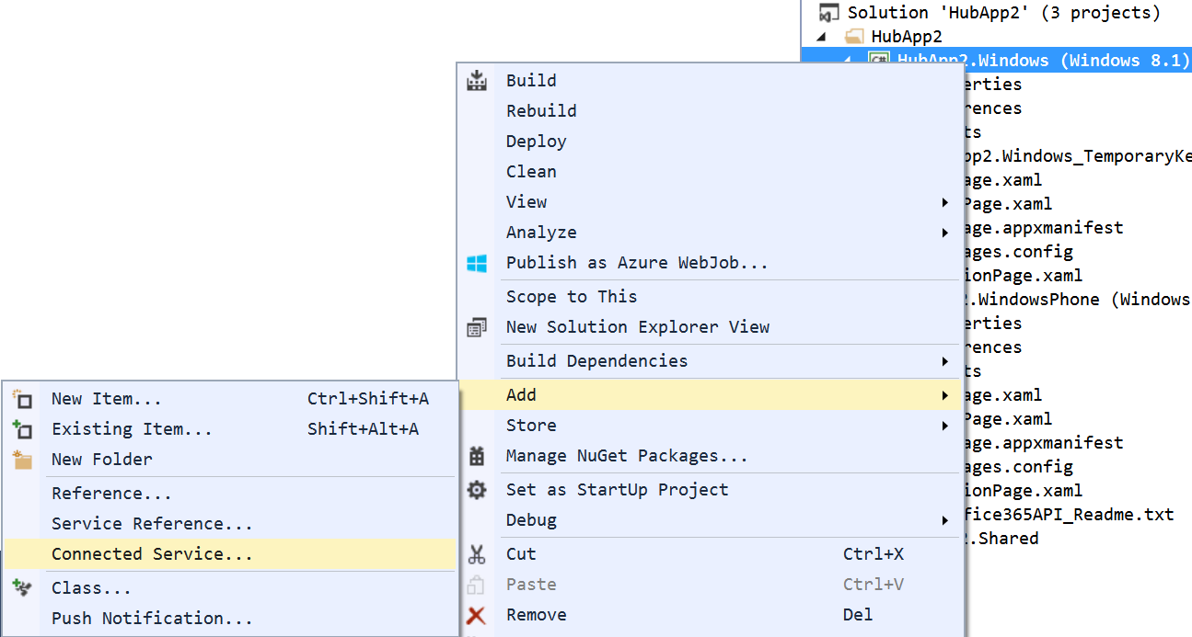
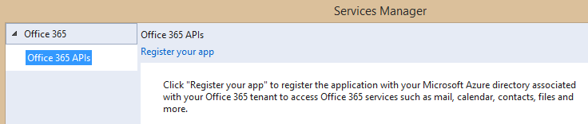
Adding Connected Services
1
Project > Add > Connected Service…
2
Register your app

Slide 17
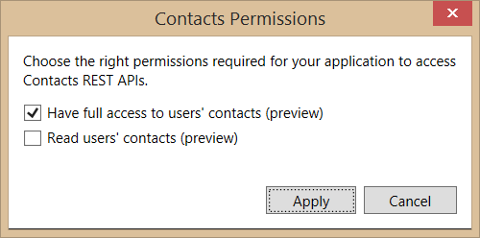
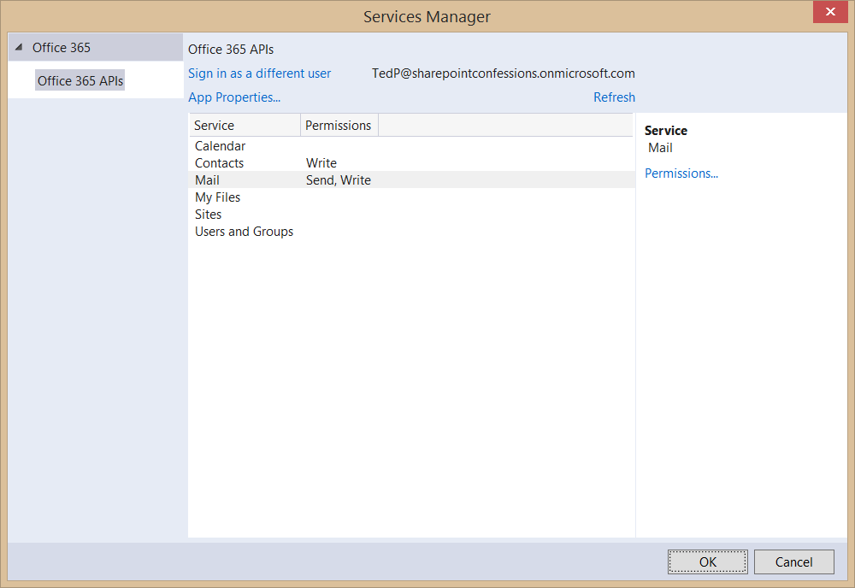
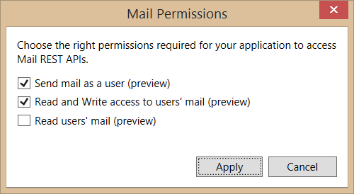
Connected Services Permissions
3
Select required app permissions

Slide 18
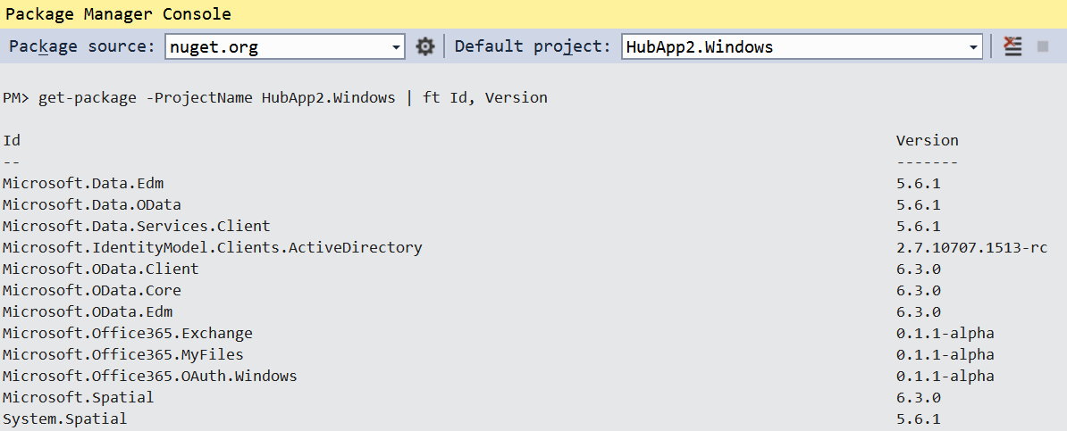
Add Connected Service
Installs NuGet Packages for Office 365 and dependencies

Slide 19
OAuth Implementation
Web-based apps use passive authentication
Accomplished via browser redirects
Universal Apps use active authentication
App code (or library code) initiates call to authentication source
The “Connected Service” wizard adds the appropriate library
Microsoft.Office365.OAuth.Web.dll for web projects
Microsoft.Office365.OAuth.WindowsStore.dll for native projects

Slide 20
Authentication in O365 API Libraries
How it works
Create a DiscoveryContext
DiscoveryContext will invoke WebAuthenticationBroker (WAB)
WAB will display logon form and common consent form
if (_discoveryContext == null)
{
_discoveryContext = await DiscoveryContext.CreateAsync();
}

Slide 21
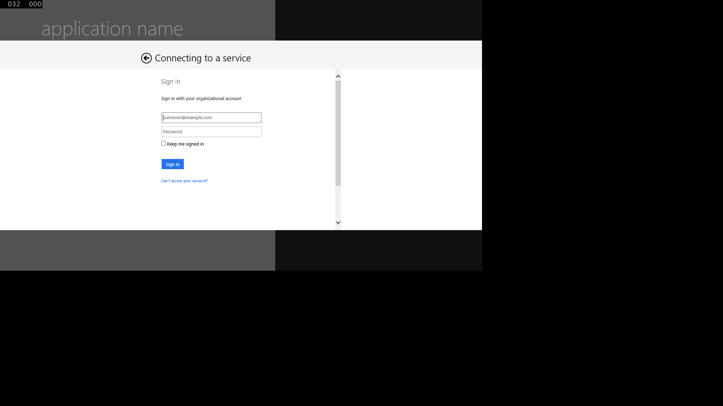
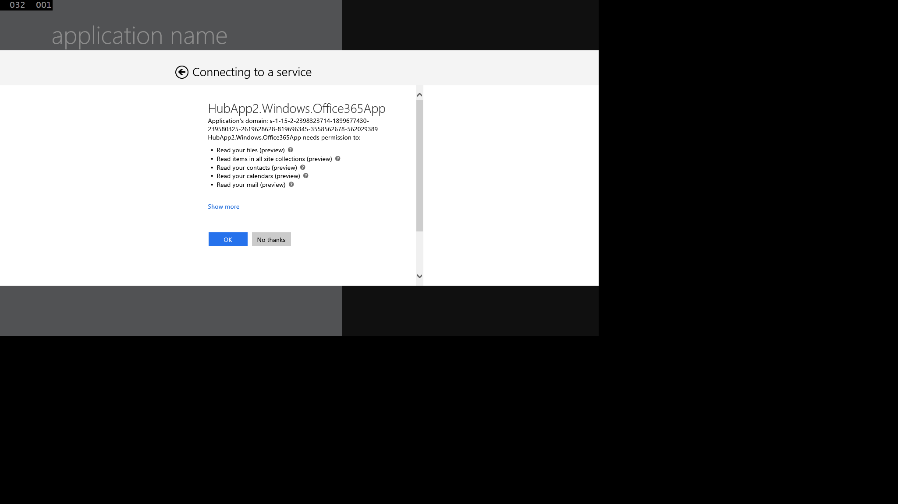
Authentication UI

Slide 22
Office 365 Service Communication
“Client” objects for each service
ExchangeClient
SharePointClient
Constructor takes a “token getter” function
DiscoveryContext wraps an AuthenticationContext
AuthenticationContext has methods for getting tokens

Slide 23
“Client” object constructor example
return new ExchangeClient(ExchangeServiceEndpointUri, async () =>
{
return (await _discoveryContext.AuthenticationContext
.AcquireTokenSilentAsync(
ExchangeServiceResourceId,
_discoveryContext.AppIdentity.ClientId,
new ActiveDirectory.UserIdentifier(
dcr.UserId,
UserIdentifierType.UniqueId)
)
).AccessToken;
});

Slide 24
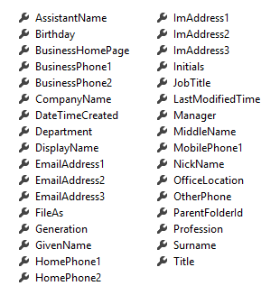
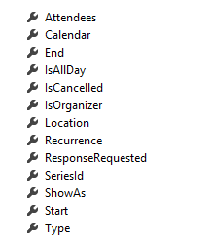
Office 365 Service Communication
Client Object exposes properties
Most are IEnumerable<T> collections
Designed much like Entity Framework
Client == DataContext
IEnumerable<T> entities
Includes common CRUD operations
Contact
Event

Slide 25
Summary
Introduction
Universal App projects
Integrating Office 365 APIs

Slide 26



Building skills
Add screens shot from link
Microsoft Virtual Academy
dev.office.com/training
Code Samples
dev.office.com/code-samples
DX Office 365 Dev Camps
Office 365 Summit Developer Tracks
summit.office.com

Slide 27

Make look cool
Developer Patterns & Practices
Transform your code
Providing App Model Patterns for common SharePoint Full Trust Code and Office Add-in scenarios
60+ Visual Studio projects
Common scenarios Branding Site provisioning Remote event receivers
Large file support Taxonomy driven navigation And much more… aka.ms/OfficeDevPnP

Slide 28
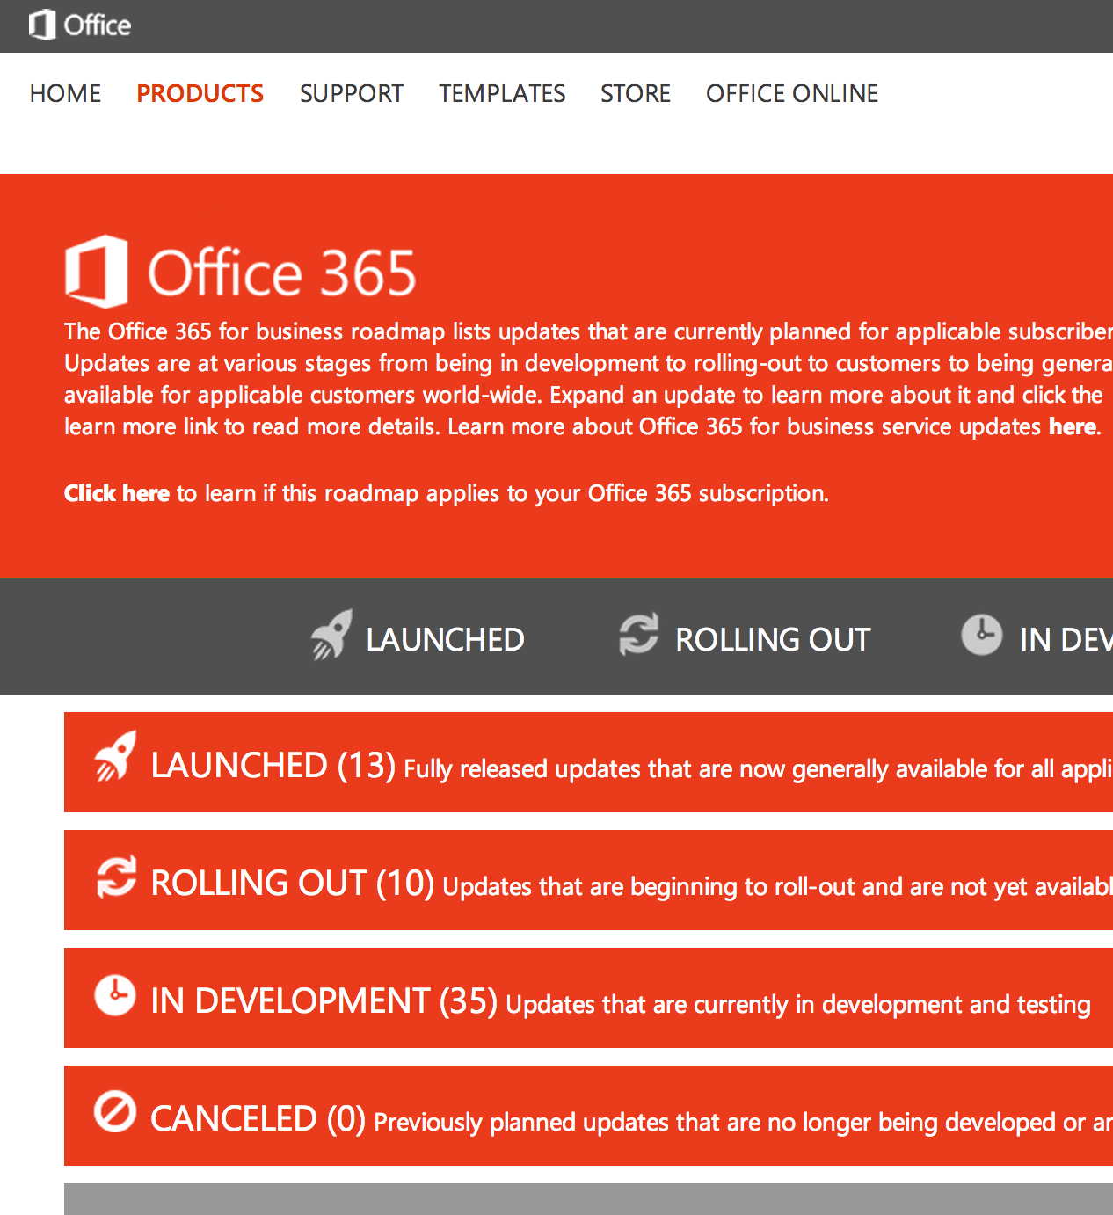
Roadmap
Monthly updates
Associated blog posts
www.office.com/roadmap

Slide 29
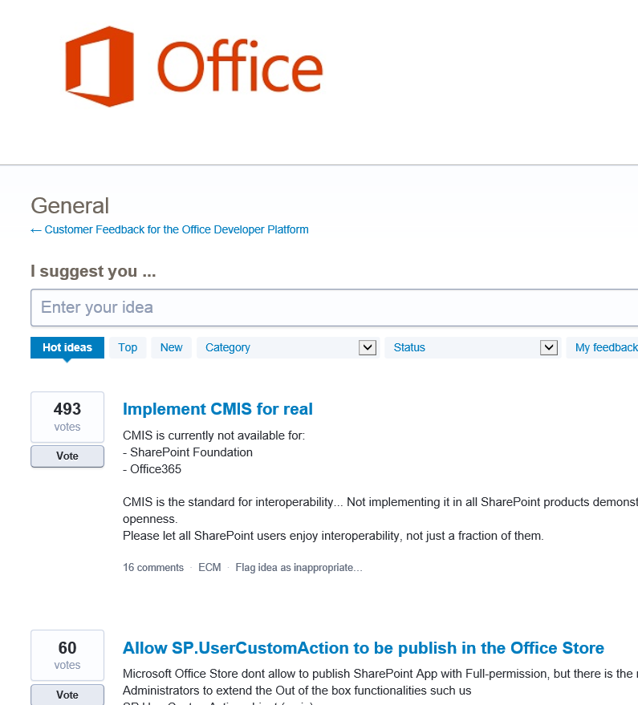

Customer feedback
Yammer Office 365 Technical Network
Stackoverflow
UserVoice Developer focused Bi-weekly triage Link to roadmap to show actions
http://aka.ms/OfficeDevFeedback

